Slide 1

Predicting Sales Model
Presented by: Arnaldo Alonso

Slide 2
Problem Identification
On this project, we made a model that predicts the amount of weekly sales a Walmart store could have as a function of variables such as store, and department number, unemployment rate of the area, CPI, size and type of store, and many others.

Slide 3
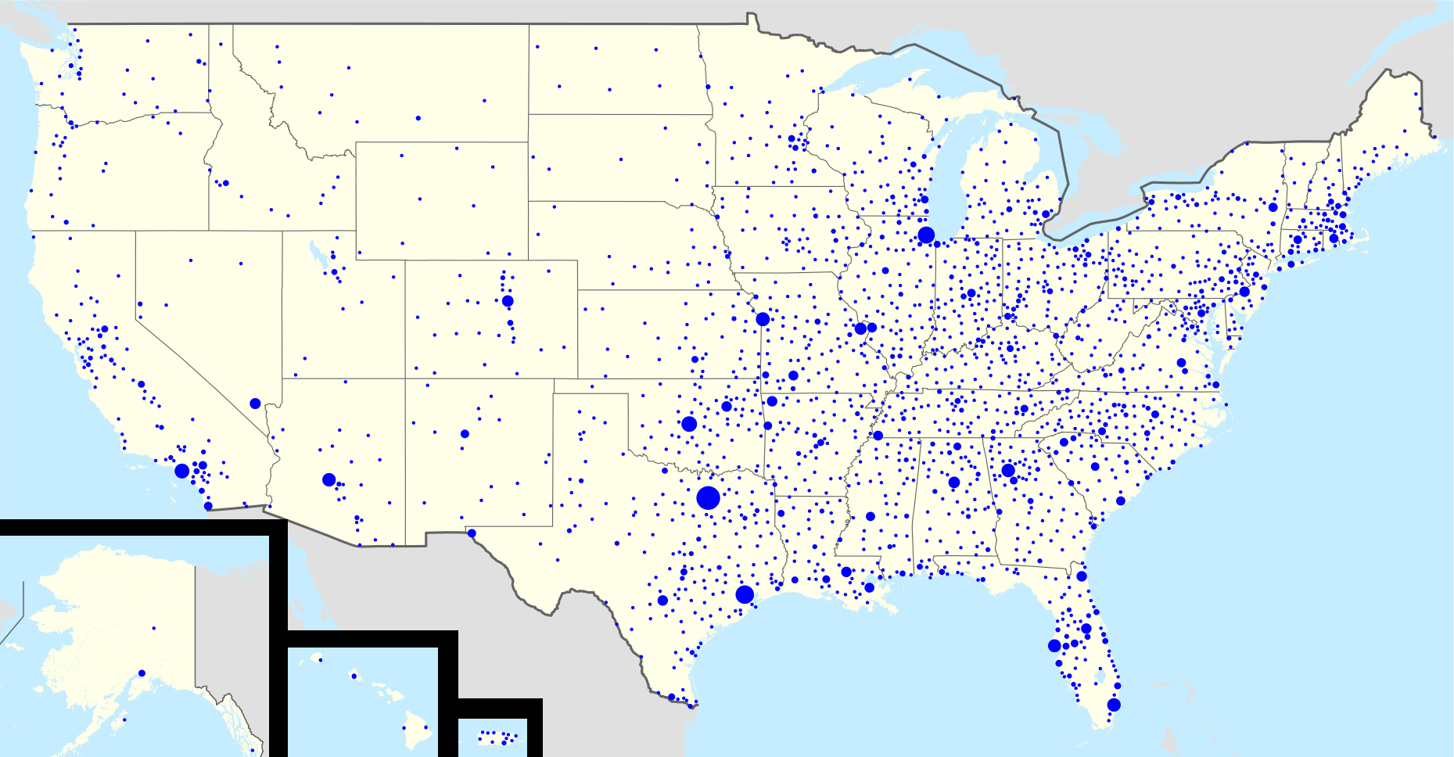
What is Walmart?
Walmart is a multinational retail corporation characterized for the competitive prices on their products.
Walmart is a corporation which has operations in all the states of the United States.
Walmart is the world’s largest company by revenue according to the Fortune Global 500 list.

Slide 4


Who might be interested?
Walmart’s CEO.
Walmart’s shareholders.
Walmart’s stakeholders

Slide 5





Steps
Data Collection
Data Wrangling
Data Visualization
Modeling
Conclusions

Slide 6
Data Collection
Data was collected from Kaggle dataset and yahoo finance.
Number of data tables: 4.
Number of features: 17.
Dimensions: 409,727 rows and 17 columns.

Slide 7
Data Wrangling
Pandas function: Inner Merge.
Handling null-values: pandas fillna function.
Transform to categorical features: Pandas function get dummies.

Slide 8
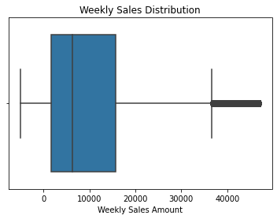
Data Visualization

Slide 9
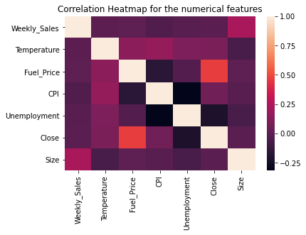
Correlation Heatmap

Slide 10
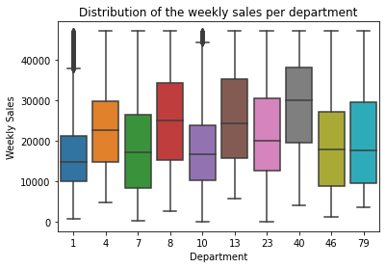
Distribution by department

Slide 11
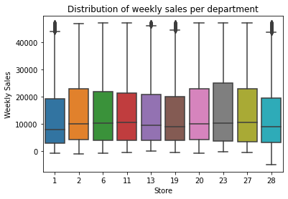
Distribution by store

Slide 12
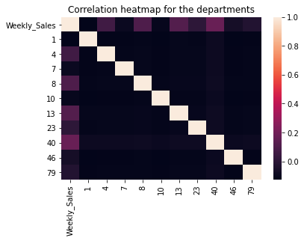
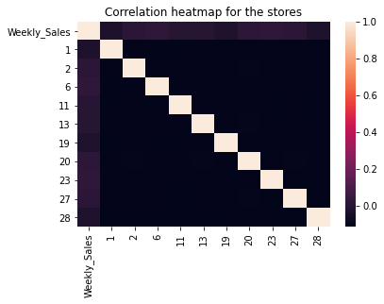
Departments and Stores Correlation Heatmap

Slide 13
Hypothesis Testing
For department
Hypothesis: Department 8 would tend to higher mean on sales than the other nine departments.
For Store
Hypothesis : Store 23 would have in overall higher mean than the mean of the other 9 stores

Slide 14
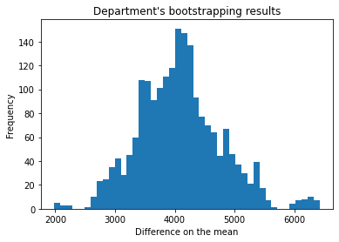
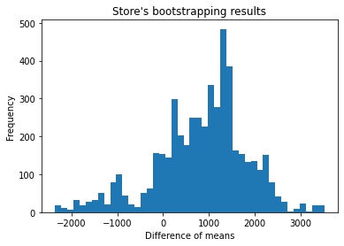
Results
p-value = 0.0
p-value = 0.1718

Slide 15
Modeling
Linear Regression
Lasso Regression
Ridge Regression
Random Forest Regressor
Gradient Boosting Regressor
Decision Tree Regressor

Slide 16
Modeling Process
Reduce Dimensionality
Define independent variables and dependent variable (weekly sales).
Divide into train and test data
For some models we did grid search and for some we did not.
Define the model, fit based on the train data and make the predictions based on the test data.

Slide 17
Results
Model | Train Score | Test Score
Standard Linear Regression | 0.7842 | 0.6237
Lasso Regression | 0.7842 | 0.6238
Ridge Regression | 0.7942 | 0.6237
Decision Tree Regressor | 0.8529 | 0.7539
Random Forest Regressor | 0.8564 | 0.76
Gradient Boosting Regressor | 0.93507 | 0.83718

Slide 18
Results without reducing dimensionality
Model | Train Score | Test Score
Random Forest Regressor | 0.8597 | 0.7617
Gradient Boosting Regressor | 0.9463 | 0.835

Slide 19
Features coefficients
Variable | Coefficient
Dept 38 | 18,354.74
Dept 95 | 15,176.39
Dept 40 | 14,367.16
Dept 72 | 11,955.30
Dept 2 | 10,618.36
Dept 13 | 7,957.89
Dept 92 | 7,696.27
Dept 8 | 6,676.25
Dept 4 | 4,543.32
Type B | 2,316.18
Variable | Coefficient
Dept 38 | 17,836.78
Dept 95 | 16,211.45
Dept 40 | 15,323.88
Dept 72 | 12,693.05
Dep 2 | 11,439.24
Store 12 | 8,783.32
Dept 13 | 7,867.23
Store 23 | 7,723.57
Store 10 | 6,984.88
Store 35 | 6,611.97
Intercept = 5077.49
Intercept = -8,230.66

Slide 20
Final Insights
I was able to create a good model to predict the weekly sales a Walmart store could have by using all the variables.
I was able to know the more important variables by checking the coefficients. With the coefficients and intercept we could calculate the weekly sales for the store.

